Slide 1
CSE 2201
Design and Analysis of Algorithms – I
Lecture 5
Minimum Spanning Tree (Prim’s), Single Source Shortest Path (Dijkstra)
Hasnain Heickal
Assistant Professor
Department of CSE, University of Dhaka

Slide 2
MST - PRIM

Slide 3
Problem: Laying Telephone Wire
Central office

Slide 4
Wiring: Naïve Approach
Central office
Expensive!

Slide 5
Wiring: Better Approach
Central office
Minimize the total length of wire connecting the customers

Slide 6
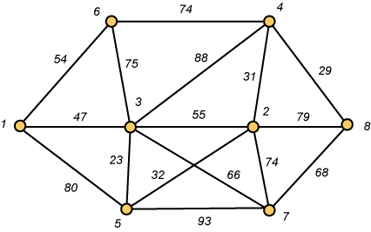
A Networking Problem
Problem: The vertices represent 8 regional data centers which need to be connected with high-speed data lines. Feasibility studies show that the links illustrated above are possible, and the cost in millions of dollars is shown next to the link. Which links should be constructed to enable full communication (with relays allowed) and keep the total cost minimal.

Slide 7
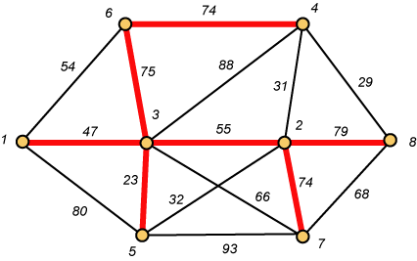
Links Will Form a Spanning Tree
Cost (T) = 47 + 23 + 75 + 74 + 55 + 74 + 79
= 427

Slide 8
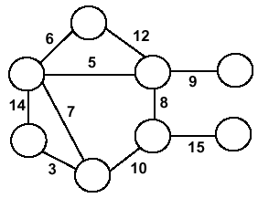
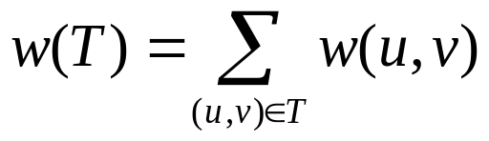
Minimum Spanning Trees
Undirected, connected graph G = (V,E)
Weight function W: E → R (assigning cost or length or other values to edges)
Spanning tree: tree that connects all the vertices (above?)
Minimum spanning tree: tree that connects all the vertices and minimizes

Slide 9
Minimum Spanning Tree (MST)
A minimum spanning tree is a subgraph of an undirected weighted graph G, such that
it is a tree (i.e., it is acyclic)
it covers all the vertices V
  contains |V| - 1 edges
the total cost associated with tree edges is the minimum among all possible spanning trees
not necessarily unique

Slide 10
How Can We Generate a MST?
9
b
9
b
a
2
6
a
2
6
d
d
4
5
4
5
5
4
5
4
5
e
5
e
c
c

Slide 11
Greedy Choice
We will show two ways to build a minimum spanning tree.
A MST can be grown from the current spanning tree by adding the nearest vertex and the edge connecting the nearest vertex to the MST. (Prim's algorithm)
A MST can be grown from a forest of spanning trees by adding the smallest edge connecting two spanning trees. (Kruskal's algorithm)

Slide 12
Notation
Tree-vertices: in the tree constructed so far
Non-tree vertices: rest of vertices
Prim’s Selection rule
Select the minimum weight edge between a tree-node and a non-tree node and add to the tree

Slide 13
The Prim algorithm Main Idea
Select a vertex to be a tree-node
while (there are non-tree vertices) {
if there is no edge connecting a tree node with a non-tree node
return “no spanning tree”
select an edge of minimum weight between a tree node and a non-tree node
add the selected edge and its new vertex to the tree
}
return tree
6
a
4
b
5
u
14
2
10
c
v
3
8
15
d
f

Slide 14
Prim’s Algorithm
Vertex based algorithm
Grows one tree T, one vertex at a time

Slide 15
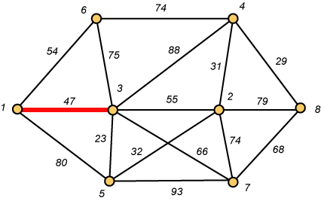
Prim – Step 1

Slide 16
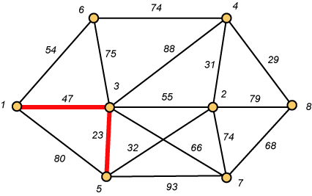
Prim – Step 2

Slide 17
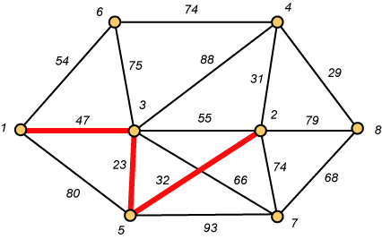
Prim – Step 3

Slide 18
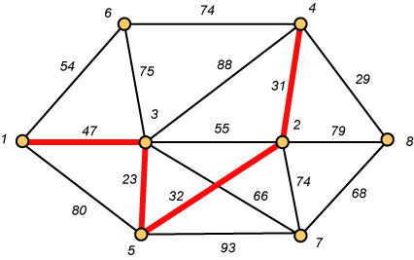
Prim – Step 4

Slide 19
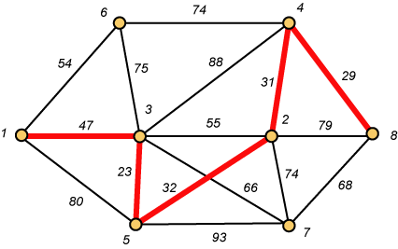
Prim – Step 5

Slide 20
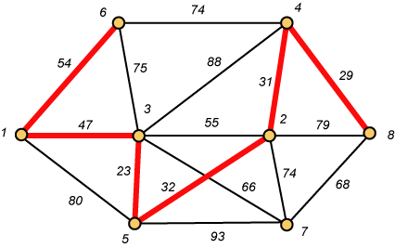
Prim – Step 6

Slide 21
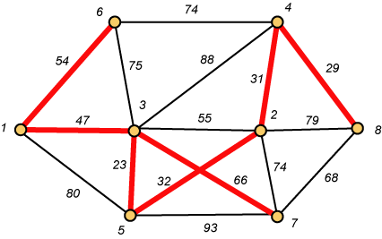
Prim – Step 7 Done!!
Weight (T) = 23 + 29 + 31 + 32 + 47 + 54 + 66 = 282

Slide 22
Prim Algorithm:Variables
r:
  Grow the minimum spanning tree from the root vertex “r”.
Q:
  is a priority queue, holding all vertices that are not in the tree now.
key[v]:
  is the minimum weight of any edge connecting v to a vertex already in the tree.
π [v]:
  names the parent of v in the tree.
T[v] –
  Vertex v is already included in MST if T[v]==1, otherwise, it is not included yet.

Slide 23
Prim Algorithm (2)
MST-Prim(G,w,r)
for each u ∈ Q
key[u] ← ∞
key[r] ← 0 // r is the first tree node, let r=1
π[r] ← NIL
Q.insert((key[r], r))
while Q ≠ ∅ do
u ← Q.ExtractMin()
make u part of T
for each v ∈ Adj[u] do
if v ∈ T and w(u,v) < key[v] then
π[v] ← u
key[v] ← w(u,v)
Q.insert((key[v], v));

Slide 24
The execution of Prim's algorithm(moderate part)
8
7
the root vertex
b
c
d
9
4
2
a
11
i
14
e
4
7
6
8
10
h
g
f
1
2
V | a | b | c | d | e | f | g | h | i
T | 1 | 0 | 0 | 0 | 0 | 0 | 0 | 0 | 0
Key | 0 | - | - | - | - | - | - | - | -
π | -1 | - | - | - | - | - | - | - | -

Slide 25
The execution of Prim's algorithm(moderate part)
8
7
the root vertex
b
c
d
9
4
2
a
11
i
14
e
4
7
6
8
10
h
g
f
1
2
V | a | b | c | d | e | f | g | h | i
T | 1 | 0 | 0 | 0 | 0 | 0 | 0 | 0 | 0
Key | 0 | 4 | - | - | - | - | - | 8 | -
π | -1 | a | - | - | - | - | - | a | -

Slide 26
The execution of Prim's algorithm(moderate part)
8
7
the root vertex
b
c
d
9
4
2
a
11
i
14
e
4
7
6
8
10
h
g
f
1
2
Important: Update Key[v] only if T[v]==0
V | a | b | c | d | e | f | g | h | i
T | 1 | 1 | 0 | 0 | 0 | 0 | 0 | 0 | 0
Key | 0 | 4 | 8 | - | - | - | - | 8 | -
π | -1 | a | b | - | - | - | - | a | -

Slide 27
The execution of Prim's algorithm(moderate part)
8
7
the root vertex
b
c
d
9
4
2
a
11
i
14
e
4
7
6
8
10
h
g
f
1
2
V | a | b | c | d | e | f | g | h | i
T | 1 | 1 | 1 | 0 | 0 | 0 | 0 | 0 | 0
Key | 0 | 4 | 8 | 7 | - | 4 | - | 8 | 2
π | -1 | a | b | c | - | c | - | a | c

Slide 28
The execution of Prim's algorithm(moderate part)
8
7
the root vertex
b
c
d
9
4
2
a
11
i
14
e
4
7
6
8
10
h
g
f
1
2
V | a | b | c | d | e | f | g | h | i
T | 1 | 1 | 1 | 0 | 0 | 0 | 0 | 0 | 1
Key | 0 | 4 | 8 | 7 | - | 4 | 6 | 7 | 2
π | -1 | a | b | c | - | c | i | i | c

Slide 29
The execution of Prim's algorithm(moderate part)
8
7
the root vertex
b
c
d
9
4
2
a
11
i
14
e
4
7
6
8
10
h
g
f
1
2
V | a | b | c | d | e | f | g | h | i
T | 1 | 1 | 1 | 0 | 0 | 1 | 0 | 0 | 1
Key | 0 | 4 | 8 | 7 | 10 | 4 | 2 | 7 | 2
π | -1 | a | b | c | f | c | f | i | c

Slide 30
The execution of Prim's algorithm(moderate part)
8
7
the root vertex
b
c
d
9
4
2
a
11
i
14
e
4
7
6
8
10
h
g
f
1
2
V | a | b | c | d | e | f | g | h | i
T | 1 | 1 | 1 | 0 | 0 | 1 | 1 | 0 | 1
Key | 0 | 4 | 8 | 7 | 10 | 4 | 2 | 1 | 2
π | -1 | a | b | c | f | c | f | g | c

Slide 31
The execution of Prim's algorithm(moderate part)
8
7
the root vertex
b
c
d
9
4
2
a
11
i
14
e
4
7
6
8
10
h
g
f
1
2
V | a | b | c | d | e | f | g | h | i
T | 1 | 1 | 1 | 0 | 0 | 1 | 1 | 1 | 1
Key | 0 | 4 | 8 | 7 | 10 | 4 | 2 | 1 | 2
π | -1 | a | b | c | f | c | f | g | c

Slide 32
The execution of Prim's algorithm(moderate part)
8
7
the root vertex
b
c
d
9
4
2
a
11
i
14
e
4
7
6
8
10
h
g
f
1
2
V | a | b | c | d | e | f | g | h | i
T | 1 | 1 | 1 | 1 | 0 | 1 | 1 | 1 | 1
Key | 0 | 4 | 8 | 7 | 9 | 4 | 2 | 1 | 2
π | -1 | a | b | c | d | c | f | g | c

Slide 33
The execution of Prim's algorithm(moderate part)
8
7
the root vertex
b
c
d
9
4
2
a
11
i
14
e
4
7
6
8
10
h
g
f
1
2
V | a | b | c | d | e | f | g | h | i
T | 1 | 1 | 1 | 1 | 1 | 1 | 1 | 1 | 1
Key | 0 | 4 | 8 | 7 | 9 | 4 | 2 | 1 | 2
π | -1 | a | b | c | d | c | f | g | c

Slide 34
Prim Algorithm (2)
MST-Prim(G,w,r)
for each u ∈ Q
key[u] ← ∞
key[r] ← 0 // r is the first tree node, let r=1
π[r] ← NIL
Q.insert((key[r], r))
while Q ≠ ∅ do
u ← Q.ExtractMin()
make u part of T
for each v ∈ Adj[u] do
if v ∈ T and w(u,v) < key[v] then
π[v] ← u
key[v] ← w(u,v)
Q.insert((key[v], v));
O(V)
Heap: O(lgV)
O(V)
Heap: O(lgV)
Overall: O(E)
Heap: O(lgV)
Overall complexity: O(V)+O(V lg V+E lg V) = O(E lg V)

Slide 35
Overall Complexity Analysis
O(n²)
  When we don’t use heap
  To find the minimum element, we traverse the “KEY” array from beginning to end
  We use adjacency matrix to update KEY.
O(ElogV)
  When min-heap is used to find the minimum element from “KEY”.
O(E+VlogV)
  When fibonacci heap is used to find the minimum element from “KEY”.

Slide 36
SINGLE SOURCE SHORTEST PATH(DIJKSTRA’S ALGORITHM)

Slide 37
Shortest Path Problems
What is shortest path ?
  shortest length between two vertices for an unweighted graph:
  smallest cost between two vertices for a weighted graph:
B
B
210
A
A
450
60
190
C
unweighted graph
C
weighted graph
200
130
D
D
E
E

Slide 38
Shortest Path Problems
How can we find the shortest route between two points on a map?
Model the problem as a graph problem:
  Road map is a weighted graph:
  vertices = cities
  edges = road segments between cities
  edge weights = road distances
  Goal: find a shortest path between two vertices (cities)

Slide 39
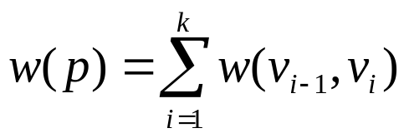
Shortest Path Problems
Input:
  Directed graph G = (V, E)
  Weight function w : E → R
Weight of path p = ⟨v₀, v₁, . . . , v_{k}⟩
Shortest-path weight from u to v:
δ(u, v) = min w(p) : u v if there exists a path from u to v
∞ otherwise
Shortest path u to v is any path p such that w(p) = δ(u, v)
t
x
3
6
9
3
4
s
0
2
1
2
7
5
3
5
11
6
y
z
p

Slide 40
Variants of Shortest Paths
Single-source shortest path
  G = (V, E) ⇒ find a shortest path from a given source vertex s to each vertex v ∈ V
Single-destination shortest path
  Find a shortest path to a given destination vertex t from each vertex v
  Reverse the direction of each edge ⇒ single-source
Single-pair shortest path
  Find a shortest path from u to v for given vertices u and v
  Solve the single-source problem
All-pairs shortest-paths
  Find a shortest path from u to v for every pair of vertices u and v

Slide 41
Optimal Substructure of Shortest Paths
Given:
  A weighted, directed graph G = (V, E)
  A weight function w: E → R,
  A shortest path p = ⟨v₁, v₂, . . . , v_{k}⟩ from v₁ to v_{k}
  A subpath of p: p_{ij} = ⟨v_{i}, v_{i+1}, . . . , v_{j}⟩, with 1 ≤ i ≤ j ≤ k
Then: p_{ij} is a shortest path from v_{i} to v_{j}
Proof: p = v₁ v_{i} v_{j} v_{k}
w(p) = w(p_{1i}) + w(p_{ij}) + w(p_{jk})
Assume ∃ p_{ij}’ from v_{i} to v_{j} with w(p_{ij}’) < w(p_{ij})
⇒ w(p’) = w(p_{1i}) + w(p_{ij}’) + w(p_{jk}) < w(p) contradiction!
v_{j}
p_{ij}
p_{jk}
v₁
p_{1i}
p_{ij}’
v_{k}
v_{i}
p_{1i}
p_{ij}
p_{jk}

Slide 42
Shortest-Path Representation
For each vertex v ∈ V:
d[v] = δ(s, v): a shortest-path estimate
  Initially, d[v]=∞
  Reduces as algorithms progress
π[v] = predecessor of v on a shortest path from s
  If no predecessor, π[v] = NIL
  π induces a tree—shortest-path tree
Shortest paths & shortest path trees are not unique
t
x
3
6
9
3
4
s
0
2
1
2
7
5
3
5
11
6
y
z

Slide 43
Initialization
Alg.: INITIALIZE-SINGLE-SOURCE(V, s)
for each v ∈ V
do d[v] ← ∞
π[v] ← NIL
d[s] ← 0
All the shortest-paths algorithms start with INITIALIZE-SINGLE-SOURCE

Slide 44
Relaxation
Relaxing an edge (u, v) = testing whether we can improve the shortest path to v found so far by going through u
  If d[v] > d[u] + w(u, v)
  we can improve the shortest path to v
  ⇒ update d[v] and π[v]
s
s
u
v
u
v
After relaxation:
  d[v] ≤ d[u] + w(u, v)
5
2
9
5
2
6
RELAX(u, v, w)
RELAX(u, v, w)
u
v
u
v
5
2
7
5
2
6

Slide 45
RELAX(u, v, w)
if d[v] > d[u] + w(u, v)
then d[v] ← d[u] + w(u, v)
π[v] ← u
All the single-source shortest-paths algorithms
  start by calling INIT-SINGLE-SOURCE
  then relax edges
The algorithms differ in the order and how many times they relax each edge

Slide 46
Dijkstra’s Algorithm
Single-source shortest path problem:
  No negative-weight edges: w(u, v) > 0 ∀ (u, v) ∈ E
Maintains two sets of vertices:
  S = vertices whose final shortest-path weights have already been determined
  Q = vertices in V – S: min-priority queue
    Keys in Q are estimates of shortest-path weights (d[v])
Repeatedly select a vertex u ∈ V – S, with the minimum shortest-path estimate d[v]

Slide 47
Dijkstra (G, w, s)
t
1
x
INITIALIZE-SINGLE-SOURCE(V, s)
S ← ∅
Q ← V[G]
while Q ≠ ∅
do u ← EXTRACT-MIN(Q)
S ← S ∪ {u}
for each vertex v ∈ Adj[u]
do RELAX(u, v, w)
∞
∞
10
9
s
0
2
3
4
6
5
7
∞
∞
2
y
z
t
1
x
∞
∞
10
10
9
s
0
2
3
4
6
5
7
∞
∞
5
2
y
z

Slide 48
Example
t
1
x
t
1
x
10
∞
8
14
8
14
13
10
9
10
9
s
0
2
3
4
6
s
0
2
3
4
6
5
7
5
7
5
∞
5
7
7
2
2
y
z
y
z
t
x
t
1
x
1
8
9
8
13
9
10
9
10
9
2
3
4
6
s
0
2
3
4
6
s
0
5
7
5
7
5
7
5
7
2
2
y
z
y
z

Slide 49

Dijkstra’s Pseudo Code
Graph G, weight function w, root s
relaxing edges

Slide 50
Dijkstra (G, w, s)
INITIALIZE-SINGLE-SOURCE(V, s)
S ← ∅
Q ← V[G]
while Q ≠ ∅
do u ← EXTRACT-MIN(Q)
S ← S ∪ {u}
for each vertex v ∈ Adj[u]
do RELAX(u, v, w)
Running time: O(VlgV + ElgV) = O(ElgV)
Θ(V)
O(V) build min-heap
Executed O(V) times
O(lgV)
O(E) times; O(lgV)

Slide 51
Dijkstra’s Running Time
Extract-Min executed |V| time
Decrease-Key executed |E| time
Time = |V| T_{Extract-Min} + |E| T_{Decrease-Key}
T depends on different Q implementations
Q | T(Extract-Min) | T(Decrease-Key) | Total
array | Ο(V) | Ο(1) | Ο(V ²)
binary heap | Ο(lg V) | Ο(lg V) | Ο(E lg V)
Fibonacci heap | Ο(lg V) | Ο(1) (amort.) | Ο(V lgV + E)

Slide 52
Question
Prove that, if there exists negative edge, dijkstra’s shortest path algorithm may fail to find the shortest path
Print the shortest path for dijkstra’s algorithm
Suppose you are given a graph where each edge represents the path cost and each vertex has also a cost which represents that, if you select a path using this node, the cost will be added with the path cost. How can it be solved using Dijkstra’s algorithm?

